Slide 1

THE BOWTIE TOOLKIT
GTM Alignment
Toolkit for Predictable Recurring Revenue

Slide 2


TABLE OF CONTENTS
01 Bowtie Data Model
Overview, Template
02 Customer Journey
Overview, Current State Template, Ideal State Template
03 Metrics
Reference, Overview, Template
04 KPI Dashboard
Overview, Example, Template
05 RACI
Overview, Template
06 AI Adoption
Overview, Example, Template
Available to Growth Institute Members Only
07 Operating Model
Overview, Example, Template
08 Stakeholder Map
Overview, Template
09 Data Model Mapped to GTM Motions
Overview, Template
10 Tech Stack
Overview, Template
11 Growth Loops
Overview, Template

Slide 3
01 OVERVIEW
BOWTIE DATA MODEL
About the Model:
The Bowtie Data Model provides a complete framework for measuring and optimizing the customer journey—from first touch through expansion revenue.
The Data Model covers every stage of customer engagement: initial awareness, consideration, purchase, implementation, and full value realization.
The Data Structure establishes a measurement standard that allows you to compare GTM motions against each other and track performance over time.
The Benchmark enables comparison against industry peers and best practices, helping you identify gaps and prioritize improvements.
How to Use This Worksheet:
Define your stages — Confirm that the stage labels (Prospects → Leads → Opportunities → Wins → Live → Customers → Growth) match your GTM motion.
Enter time metrics (Δt) — Record the average time between each stage transition. This reveals where deals stall.
Enter conversion rates (CR) — Input the percentage of records that advance from each stage to the next. Low conversions indicate process breakdowns.
Enter volume metrics (VM) — Track the count of records at each stage (leads, ARR, etc.) to understand pipeline health.
Compare and iterate — Use the benchmark data to identify your biggest gaps, then focus improvement efforts there.

Slide 4
01 TEMPLATE
BOWTIE DATA MODEL
LEADGEN
Prospects
LEADDEV
Leads
SELLING
Opportunities
ACTIVATE
Wins
ONBOARD
Live
RETAIN
Customers
EXPAND
Growth
[Enter Δt1]
[Enter Δt2]
[Enter Δt3]
[Enter Δt4]
[Enter Δt5]
[Enter Δt6]
[Enter Δt7]
[Enter Δt8]
Δt: Time
Δt1
Δt2
Δt3
Δt4
Δt5
Δt6
Δt7
Δt8
Sales Cycle
CR: Conversion Rates
[Enter CR1]
[Enter CR2]
[Enter CR3]
[Enter CR4]
[Enter CR5]
[Enter CR6]
[Enter CR7]
[Enter CR8]
Win rate, NRR
CR1
CR2
CR3
CR4
CR5
CR6
CR7
CR8
VM: Volume Metrics
VM1
VM2
VM3
VM4
VM5
VM6
VM7
VM8
VM9
Leads, ARR
[Enter VM1]
[Enter VM2]
[Enter VM3]
[Enter VM4]
[Enter VM5]
[Enter VM6]
[Enter VM7]
[Enter VM8]
[Enter VM9]

Slide 5
02 OVERVIEW
CUSTOMER JOURNEY
About the Customer Journey:
The Customer Journey maps the complete set of experiences and interactions a customer goes through when engaging with your company. It encompasses stages from initial awareness through consideration, purchasing, implementation, and full value realization.
The Bowtie model extends the classic Sales and Marketing funnel to cover the entire customer journey. While traditional funnels end at acquisition, the Bowtie provides equal emphasis on stages leading to Retention and Expansion.
This customer-centric approach shifts focus from value-based selling (acquisition) to impact-based thinking (retention and expansion), recognizing that in subscription businesses, what happens after the deal closes is what secures revenue and growth.
How to Use This Worksheet:
Understand the Bowtie — The full recurring revenue lifecycle—pre-sale motion narrowing to the win, then expanding through customer success.
Fill in each stage — List the plays, handoffs, and metrics that move customers from one phase to the next.
Current State = your reality — How your GTM teams actually operate today, gaps included.
Ideal State = your blueprint — The customer-centric experience you'd build with proper Revenue Architecture.
The gap is your roadmap — Prioritize where the delta is greatest and impact on recurring revenue is highest.

Slide 6
02 TEMPLATE
CUSTOMER JOURNEY
CURRENT STATE
LEADGEN
Prospects
LEADDEV
Leads
SELLING
Opportunities
ACTIVATE
Wins
ONBOARD
Live
RETAIN
Customers
EXPAND
Growth
TBD
TBD
TBD
TBD
TBD
TBD
TBD
TBD
TBD
TBD
TBD
TBD
TBD
TBD
TBD
TBD
TBD
TBD
TBD
TBD
TBD
TBD
TBD
TBD
TBD
TBD
TBD
TBD
TBD
TBD
TBD
TBD
TBD
TBD
TBD
TBD
TBD
TBD
TBD
TBD
TBD
TBD

Slide 7
02 TEMPLATE
CUSTOMER JOURNEY
IDEAL STATE
LEADGEN
Prospects
LEADDEV
Leads
SELLING
Opportunities
ACTIVATE
Wins
ONBOARD
Live
RETAIN
Customers
EXPAND
Growth
TBD
TBD
TBD
TBD
TBD
TBD
TBD
TBD
TBD
TBD
TBD
TBD
TBD
TBD
TBD
TBD
TBD
TBD
TBD
TBD
TBD
TBD
TBD
TBD
TBD
TBD
TBD
TBD
TBD
TBD
TBD
TBD
TBD
TBD
TBD
TBD
TBD
TBD
TBD
TBD
TBD
TBD

Slide 8
03 OVERVIEW
METRICS VS BENCHMARKS
About the Model:
The Metrics vs Benchmarks template enables comparison of your conversion rates against industry standards. It overlays the Data Structure on the Bowtie model, measuring Volume Metrics (VM), Conversion Rates (CR), and Time Metrics at each stage.
The Data Structure provides a standardized framework: Volume metrics measure quantity (leads, revenue, active users), Conversion metrics measure efficiency (output divided by input), and Time metrics track conversion duration.
Benchmarking against industry peers helps identify gaps and prioritize improvements. The 20% baseline represents a typical conversion rate; deviations reveal process strengths or areas needing attention across your GTM motion.
How to Use This Worksheet:
Track your Conversion Rates (CRs) — Each CR measures the transition between stages—from Prospect→MQL through to Growth. These are the leading indicators of your revenue engine.
Enter your actual rates — Replace "Your CR: NA" with your real conversion percentages at each stage.
Compare against benchmarks — The 20% benchmark is a baseline. Note where you're above, at, or below to identify strengths and leaks.
Use notes to capture context — Document what's driving performance—process gaps, resource constraints, or plays that are working.
Prioritize the biggest gaps — Low CRs reveal where deals or customers are lost. Focus GTM improvements where conversion lifts will compound across the funnel.

Slide 9
03 REFERENCE
METRICS DEFINITIONS
LEADGEN
Prospects
LEADDEV
Leads
SELLING
Opportunities
ACTIVATE
Wins
ONBOARD
Live
RETAIN
Customers
EXPAND
Growth
Prospect | MQL | SQL | Pipeline | Commit | Live | Bookings MRR | LTV
New Leads/ Contacts Created (other Awareness indicator?) | Marketing Qualified Lead or Account - Scoring threshold met, high intent | SDR qualifies deal via qual-call or email, creates opportunity and schedules discovery for rep | Stage 2 - Confirm, Disco complete, discussed products and value, $$ added to Oppty | Closed Won | Provisioned, Onboarded, Ad Campaign Launched | Monthly Recurring Revenue | Renewal + Expansion over average lifetime

Slide 10
03 TEMPLATE
METRICS VS BENCHMARKS
CR1
CR2
CR3 / CR4
CR5
CR6
CR7
CR8
LEADGEN
Prospects
LEADDEV
Leads
SELLING
Opportunities
ACTIVATE
Wins
ONBOARD
Live
RETAIN
Customers
EXPAND
Growth
CR1 | CR2 | CR3 | CR4 | CR5 | CR6 | CR7 | CR8
Prospect → MQL | MQL → SQL | SQL → SAL | SAL→ WIN | WIN → Commit | First Value | Retention | Growth
Benchmark: 20% Your CR1: NA Type notes here… | Benchmark: 20% Your CR2: NA Type notes here… | Benchmark: 20% Your CR3: NA Type notes here… | Benchmark: 20% Your CR4: NA Type notes here… | Benchmark: 20% Your CR5: NA Type notes here… | Benchmark: 20% Your CR6: NA Type notes here… | Benchmark: 20% Your CR7: NA Type notes here… | Benchmark: 20% Your CR8: NA Type notes here…

Slide 11
04 TEMPLATE
KPI DASHBOARD
About the Model:
The KPI Dashboard maps measurable Key Results across every stage of the Bowtie, from lead generation through expansion revenue. Each stage requires both Leading Indicators (activity metrics predicting future outcomes) and Lagging Indicators (result metrics confirming what happened).
Leading indicators like demos completed, onboarding tasks finished, and feature adoption percentage enable early course correction. Lagging indicators like win rate, new ARR, NRR, and time to value confirm whether plays are working.
This dashboard creates visibility across Marketing, Sales, and Customer Success, unifying the revenue team around shared metrics that span the complete customer journey.
How to Use This Worksheet:
Map metrics across the Bowtie — Each stage needs measurable Key Results—from MQL generation through expansion revenue.
Leading Indicators = activity metrics — These predict future outcomes. Examples: demos completed, onboarding tasks finished, feature adoption %.
Lagging Indicators = result metrics — These confirm what happened. Examples: win rate, new ARR, NRR, time to value.
Use both to run your GTM motion — Leading indicators let you course-correct early; lagging indicators tell you if your plays are working.
Align your team around shared KPIs — This dashboard creates visibility across Marketing, Sales, and Customer Success—one revenue team, one set of metrics.

Slide 12
04 EXAMPLE
KPI DASHBOARD
Aware/Interested Accounts & Leads (MQL)
SQL - Meetings Set
Closed/Won Opptys
Live Customers
Renewals
Closed/Won Expansion Opptys
Key Result:
Leading
Indicators
Website Visitors/Traffic from target accounts
Campaign Metrics - Total Responses, Qualified Responses
Digital Campaign Metrics: Reach, CTR, Engagement, Lift, New Accounts On Site, CVR
Form Fills - New Leads
Account/Contact Status Change
Connects/Response Rates
Activities - Emails/Dials
Opptys - Stage 1+
Stage Durations, Deal Cycle Time
Stage Conv. Rates
Touches/Meetings
Contact Roles/Key Personas Involved
Win Rate
Avg. Deal Size
Time to Account Team assignment
Time to Internal Handoff (from Close)
Time to Kickoff (SLA Met)
Time to Go-Live (TTL)
% Value Roadmaps Completed
% Value Roadmaps in use
Adoption metrics
# integrations
DB Academy metrics
Customer Health Score
Business Reviews executed
Customer Engagement
Support Tickets
CSM Perspective
Advocacy rate
Customer Engagement
Account Plans completed
Expansion opportunities created
CSQL volume
Multi-threaded Key Stakeholders
Key Result:
Lagging
Indicators
QR - MQL
MQL - SQL
SQL - Pipeline
Pipeline - CW
Conversion Rates by Channel
SQL -> Disco Conversion Rate
Pipeline
Deals, Conversion Rates by Stage
Closed/Won -> Live Conversion Rate
Churn
Expansion
CSAT/NPS
% Training Completed
First Value Achieved
% Onboarding completed
Post-Onboarding Survey
NPS/CSAT, CES
GRR ($$ and # Logos)
NRR ($$ and # Logos)
Expansion ($ and # logos)
Churn ($ and # logos)
NPS, CSAT, CES
CSQL Conversion rate

Slide 13
04 TEMPLATE
KPI DASHBOARD
Aware/Interested Accounts & Leads (MQL)
SQL - Meetings Set
Closed/Won Opptys
Live Customers
Renewals
Closed/Won Expansion Opptys
Key Result:
Leading
Indicators
Type here (e.g., Website visits, content downloads, ad impressions)
Type here (e.g., Outreach attempts, response rate, qualified lead velocity)
Type here (e.g., Proposals sent, demos completed, pipeline coverage ratio)
Type here (e.g., Onboarding tasks completed, logins per week, support tickets)
Type here (e.g., NPS score, product usage rate, health score)
Type here (e.g., Feature adoption %, upsell conversations, cross-sell qualified)
Key Result:
Lagging
Indicators
Type here (e.g., # of MQLs, cost per MQL, MQL-to-SQL rate)
Type here (e.g., # meetings booked, show rate, SQL-to-opp rate)
Type here (e.g., # deals closed, win rate, new ARR, sales cycle length)
Type here (e.g., # active customers, time to value, activation rate)
Type here (e.g., Renewal rate, logo churn, revenue retention (GRR)
Type here (e.g., Expansion ARR, NRR, upsell win rate)

Slide 14
05 OVERVIEW
RACI
About the Model:
The RACI framework clarifies role ownership across Bowtie stages. R (Responsible) does the work, A (Accountable) owns the outcome, C (Consulted) provides input, and I (Informed) stays in the loop.
Clear ownership prevents dropped handoffs and duplicated effort. The Bowtie has natural transition points where responsibility shifts between teams. RACI makes explicit who's handing off and who's picking up.
One "R" per stage, per activity is the rule. If everyone's responsible, no one is. Role clarity breaks down as teams grow, so revisit this framework when adding headcount or changing your GTM motion.
How to Use This Worksheet:
List your GTM roles — Replace Role #1–4 with actual titles—SDR, AE, CSM, AM, etc. Add rows as needed for your team structure.
Assign one letter per cell — R (Responsible) does the work, A (Accountable) owns the outcome, C (Consulted) provides input, I (Informed) stays in the loop.
One "R" per stage, per activity — If everyone's responsible, no
one is. Clear ownership prevents dropped handoffs and
duplicated effort.
Use this to clarify handoffs — The Bowtie has natural transition points. RACI makes explicit who's handing off and who's picking up.
Revisit as you scale — Role clarity breaks down as teams grow. Update this when you add headcount or change your GTM motion.

Slide 15
05 TEMPLATE
RACI
R
Responsible
A
Accountable
C
Consulted
I
Informed
LEADGEN
Prospects
LEADDEV
Leads
SELLING
Opportunities
ACTIVATE
Wins
ONBOARD
Live
RETAIN
Customers
EXPAND
Growth
ROLE #1
R
ROLE #2
A
ROLE #3
C
ROLE #4
I

Slide 16
06 OVERVIEW
AI ADOPTION
About the Model:
This AI Adoption framework gives GTM leaders a practical way to plan and prioritize AI investments across the full bowtie—from Awareness through Expansion—by anchoring every initiative to recurring impact, not isolated efficiency gains. It helps teams sequence AI projects intentionally, starting with assistive use cases that scale productivity, then progressing toward agentic capabilities that drive durable outcomes across revenue, adoption, and retention.
By mapping AI use cases to each stage of the customer journey, organizations can align Sales, Marketing, Onboarding, and Customer Success around a shared roadmap, focus resources where AI creates compounding value, and ensure adoption translates into measurable, repeatable growth.
How to Use This Worksheet:
Define the Job to Be Done
Clearly articulate what problem each AI use case is solving, who it serves, and which outcome it is meant to improve. Anchor every initiative to a single primary KPI to ensure AI adoption drives measurable GTM impact—not activity.
Score and Prioritize Use Cases
Evaluate each AI initiative using simple, consistent criteria—impact, confidence, effort, and risk—to create an objective priority order. This prevents “shiny object” decisions and focuses investment on the highest-return opportunities.
Pilot by Bowtie Stage
Test AI initiatives with a focused team or segment at each stage of the bowtie. Short pilots create fast learning loops and reduce the cost of failure.

Slide 17
06 EXAMPLE
AI ADOPTION
Recurring Revenue is the result of recurring impact
Awareness
Education
Selection
Commit
Implementation
Adoption
Expansion
Assistive | AI-driven SEO-optimized page creation | AI conversational training for SDR ramp-up | AI-powered account insight surfacing |  | AI-driven user activation workflows | AI-enhanced support response and documentation | AI competitor intelligence workflows
 | AI-powered conversational experience | AI-embedded SPICED account planning templates | In-call AI assistant for CRM data capture |  |  | AI-powered internal knowledge retrieval | AI conversational upsell insights
 | AI-driven GTM campaign asset generation | AI-enhanced prospecting signal integration | Automated AI-driven call review
 | AI-enhanced social campaign optimization | Causal AI modeling for content strategy forecasting | Real-time playbook adherence and CRM automation
Agentic | Event call nurturing | AI SDR | AI Solution Engineer |  | AI Onboarding Agent | AI Health Monitoring Agent | AI Expansion Agent (revenue operating system)
Assistive | AI-driven SEO-optimized page creation | AI conversational training for SDR ramp-up | AI-powered account insight surfacing |  | AI-driven user activation workflows | AI-enhanced support response and documentation | AI competitor intelligence workflows
 | AI-powered conversational experience | AI-embedded SPICED account planning templates | In-call AI assistant for CRM data capture |  |  | AI-powered internal knowledge retrieval | AI conversational upsell insights
 | AI-driven GTM campaign asset generation | AI-enhanced prospecting signal integration | Automated AI-driven call review
 | AI-enhanced social campaign optimization | Causal AI modeling for content strategy forecasting | Real-time playbook adherence and CRM automation
Agentic | Event call nurturing | AI SDR | AI Solution Engineer |  | AI Onboarding Agent | AI Health Monitoring Agent | AI Expansion Agent (revenue operating system)

Slide 18
06 TEMPLATE
AI ADOPTION
Recurring Revenue is the result of recurring impact
Awareness
Education
Selection
Commit
Implementation
Adoption
Expansion
Assistive
Agentic
Assistive | AI-driven SEO-optimized page creation | AI conversational training for SDR ramp-up | AI-powered account insight surfacing |  | AI-driven user activation workflows | AI-enhanced support response and documentation | AI competitor intelligence workflows
 | AI-powered conversational experience | AI-embedded SPICED account planning templates | In-call AI assistant for CRM data capture |  |  | AI-powered internal knowledge retrieval | AI conversational upsell insights
 | AI-driven GTM campaign asset generation | AI-enhanced prospecting signal integration | Automated AI-driven call review
 | AI-enhanced social campaign optimization | Causal AI modeling for content strategy forecasting | Real-time playbook adherence and CRM automation
Agentic | Event call nurturing | AI SDR | AI Solution Engineer |  | AI Onboarding Agent | AI Health Monitoring Agent | AI Expansion Agent (revenue operating system)

Slide 19
07 OVERVIEW
OPERATING MODEL OVERVIEW
About the Model:
The Operating Model ensures different customer-facing functions work together efficiently as a cohesive system. It is built upon three core elements: (1) A standardized Data Model (the Bowtie), (2) A common language across all GTM roles focused on customer impact, and (3) A uniform methodology creating seamless communication throughout the customer journey.
The Operating Model fosters seamless interaction both within individual GTM motions and across multiple motions. This becomes paramount for Scaleups required to swiftly adapt to market changes.
Success in recurring revenue relies on various roles working together, ensuring the overall system functions in harmony rather than individual functions operating in silos.
How to Use This Worksheet:
Map your plays by stage: — Document the specific activities that move customers through each phase—from Awareness through Expansion.
Use the example as your guide — The filled template shows how plays flow vertically within each stage, with clear handoff points (MQL, SQL, WIN, First Impact, etc.).
Assign ownership at the bottom — Each stage belongs to a role or team—Marketing, SDR/BDR, AE, CSM, AM. Define who runs each play.
Connect the milestones — The diamonds represent key transitions. Your plays should ladder up to these moments that matter.
Design for repeatability — This isn't a one-off deal map—it's your scalable operating model. If a play can't be repeated consistently, rethink it.

Slide 20
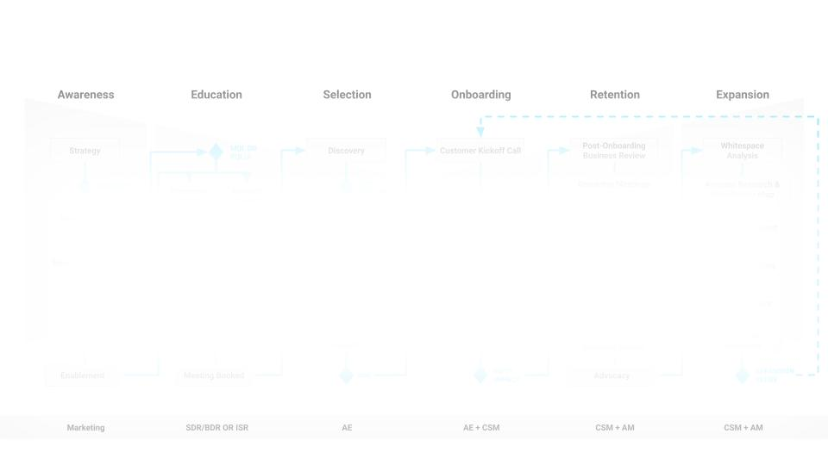

07 TEMPLATE
OPERATING MODEL OVERVIEW
Unlock this slide by joining the Winning by Design Growth Institute
Marketing
SDR/BDR OR ISR
AE
AE + CSM
CSM + AM
CSM + AM

Slide 21
08 OVERVIEW
STAKEHOLDER MAP
About the Model:
The Stakeholder Map identifies key personas at each stage of the Bowtie. Different stakeholders drive momentum at different points: Drivers for prospecting, Champions for internal advocacy, Economic Buyers for closing, Users for adoption, and Champions again for renewal.
Pre-sale stakeholders (Champion, Economic Buyer) often differ from post-sale stakeholders (User, Champion for renewal). Planning for this handoff is critical for recurring revenue success.
Multi-threading across stakeholders reduces deal fragility. This map ensures you're engaging the right people at the right moments, and keeps relationships current as they evolve through Retain and Expand stages.
How to Use This Worksheet:
Identify the key persona at each stage — Different stakeholders drive momentum at different points—Driver for prospecting, Economic Buyer for closing, User for adoption.
Add name and title for each — Move beyond generic personas. Map the actual people involved in your deals and accounts.
Note the shift at the Win — Pre-sale stakeholders (Champion, Economic Buyer) often differ from post-sale (User, Champion for renewal). Plan for this handoff.
Use this to multi-thread — Single-threaded deals are fragile. This map ensures you're engaging the right people at the right moments.
Update as relationships evolve — Stakeholders change—especially in Retain and Expand. Keep this current to protect and grow revenue.

Slide 22
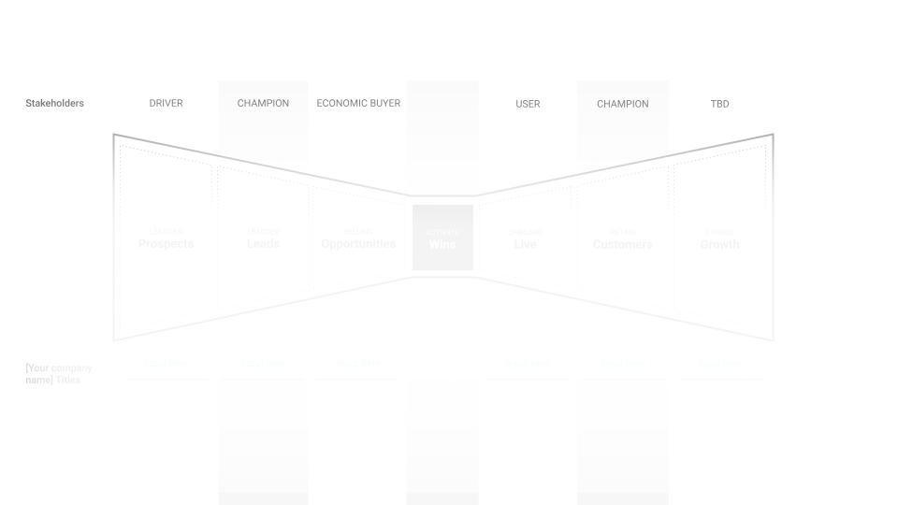
08 TEMPLATE
STAKEHOLDER MAP
Unlock this slide by joining the Winning by Design Growth Institute

Slide 23
09 OVERVIEW
DATA MODEL MAPPED
TO GTM MOTIONS
About the Model:
This template maps how different GTM motions deploy roles across the Bowtie stages. A GTM motion refers to a company's structured set of activities spanning the entire customer journey, from finding prospects to creating satisfied customers.
Different account values require different motions: 1-Stage (high-volume, low-touch) for accounts under $15k, 2-Stage (balanced efficiency and personalization) for mid-market, and Field (high-touch, custom campaigns) for enterprise accounts over $50k.
The boxes show which roles own which stages. Lower-value accounts get scalable, tech-touch motions (Pooled CS, Self-Serve); higher-value accounts get dedicated resources (CSM 1:Few, Growth AE).
How to Use This Worksheet:
Segment by account value — Each row represents a different GTM motion—1-Stage for low-touch, 2-Stage for mid-market, Field for enterprise. Define your thresholds.
Map role coverage across the Bowtie — The boxes show which roles own which stages. Adjust the span to reflect where each role starts and ends in your motion.
Match investment to opportunity — Lower-value accounts get scalable, tech-touch motions (Pooled CS, Self-Serve). Higher-value accounts get dedicated resources (CSM 1:Few, Growth AE).
Customize the roles— Replace the labels with your actual titles. The framework flexes to your org structure—what matters is clear ownership across the journey.
Design for unit economics — Your GTM motion should align cost-to-serve with potential revenue. If your CAC doesn't support the motion, redesign it.

Slide 24
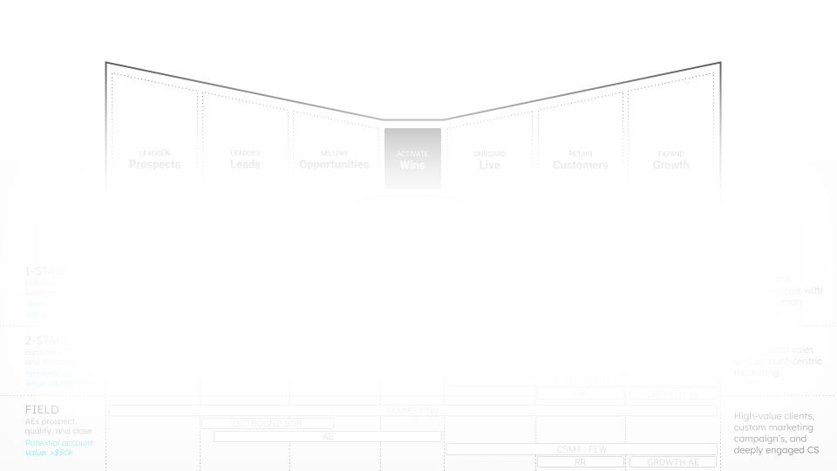
09 TEMPLATE
DATA MODEL MAPPED
TO GTM MOTIONS
Unlock this slide by joining the Winning by Design Growth Institute

Slide 25
10 OVERVIEW
TECH STACK
About the Model:
The Tech Stack template maps applications, integrated applications, and platforms across the GTM Bowtie stages. Technology enables more affordable task execution and supports the scalable, repeatable processes required for sustainable GTM motions.
Applications serve specific stages (e.g., LinkedIn for prospecting), Integrated Applications span multiple stages (e.g., Google Ads/SEO for awareness through selection), and Platforms like Salesforce/CRM serve as the foundation spanning the entire journey.
Mapping technology to the Bowtie ensures tools support seamless handoffs between stages and functions, reducing disconnects that fragment the customer experience.
How to Use This Worksheet:
Current tech Stack Enter the tech stack design at each stage.
Proposed Additions/Substractions- Color code to highlight proposed changes to your strategy.

Slide 26
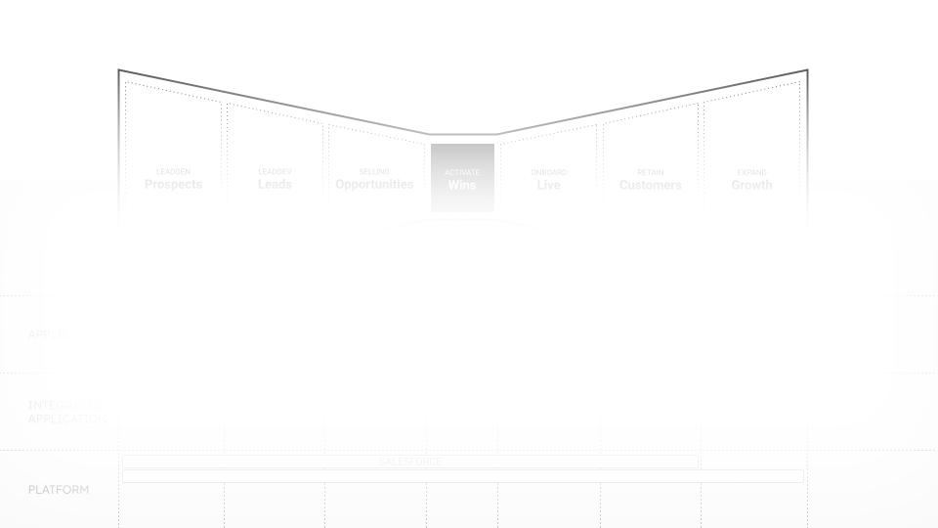
10 OVERVIEW
TECH STACK
Unlock this slide by joining the Winning by Design Growth Institute

Slide 27
11 OVERVIEW
GROWTH LOOPS
About the Model:
Growth Loops model how existing customers drive new customer acquisition. The most effective and sustainable growth stems from self-perpetuating loops: referrals from existing customers, renewals, and expansion of existing relationships.
Key variables: n (# of customers), upn (users per customer), k1 (% becoming advocates), k2 (opportunities per advocate), glo (growth loop opportunities), wr (win rate), glc (new customers from loop), and the Growth Loop Impact formula glc/n shows what percentage of growth comes from the loop itself.
Strong growth loops reduce reliance on top-of-funnel spend. If k1 or k2 are low, focus on customer impact and advocacy programs to unlock compounding, customer-led growth.
How to Use This Worksheet:
Start with your customer base — Enter n (# of customers) and upn (users per customer) to calculate your total user count. This is the foundation of your loop.
Define your advocacy multipliers — k1 is the % of users who become advocates; k2 is how many opportunities each advocate generates. These drive your growth loop opps (glo).
Apply your win rate — Multiply glo × wr to get glc—the number of new customers your growth loop generates. This closes the loop back into the Bowtie.
Calculate Growth Loop Impact — The formula glc/n shows what percentage of customer growth comes from the loop itself—your measure of compounding, customer-led growth.
Use this to prioritize investment — A strong growth loop reduces reliance on top-of-funnel spend. If k1 or k2 are low, focus on customer impact and advocacy programs.

Slide 28
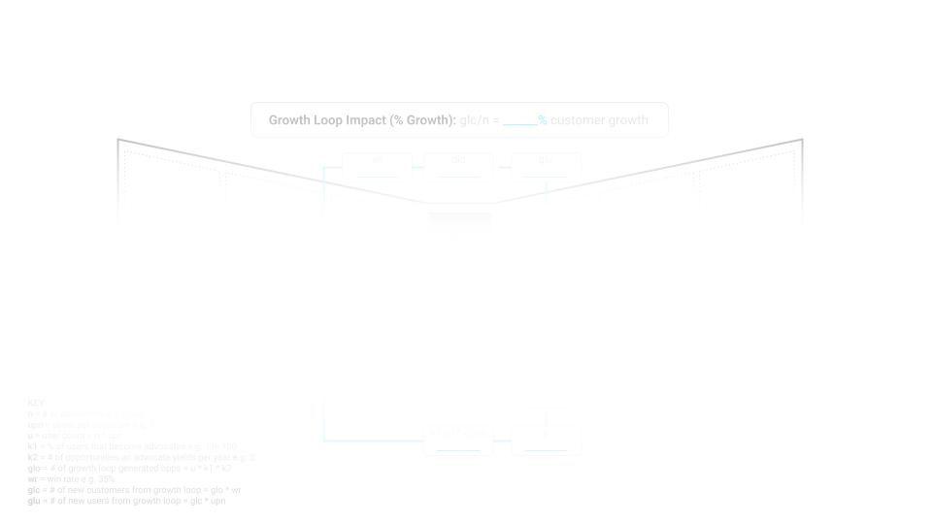
11 TEMPLATE
GROWTH LOOPS
Unlock this slide by joining the Winning by Design Growth Institute

Slide 29
THE BOWTIE TOOLKIT
END

